Slide 1
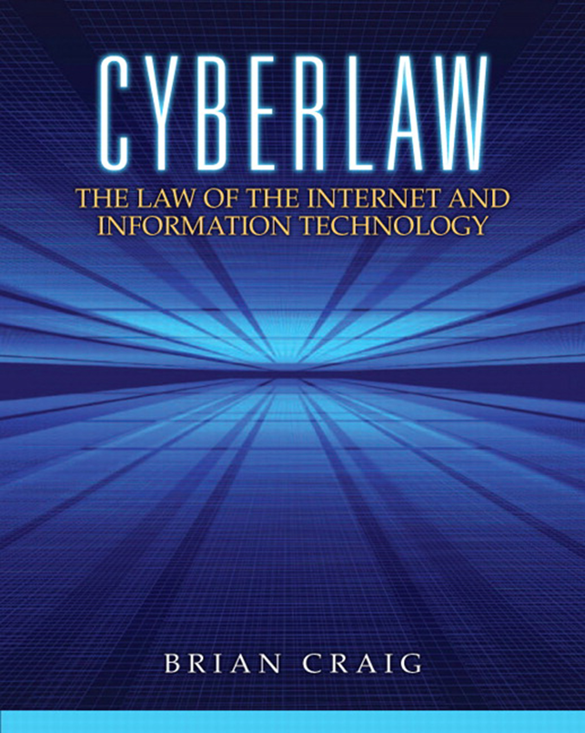

Cyberlaw: The Law of the Internet and Information Technology
First Edition
Chapter 2
Copyright Law in the Digital Age
Copyright © 2013 Pearson Education, Inc. All Rights Reserved
Notes:
If this PowerPoint presentation contains mathematical equations, you may need to check that your computer has the following installed:
1) Math Type Plugin
2) Math Player (free versions available)
3) NVDA Reader (free versions available)

Slide 2
Learning Objectives (1 of 2)
After this lecture, you should:
2.1 Compare and contrast copyright law with other areas of intellectual property law.
2.2 Explain the scope of copyright protection for websites and software
2.3 Describe the benefits of copyright notice and copyright registration

Slide 3
Learning Objectives (2 of 2)
2.4 Discuss the four fair use defense factors and how courts apply these factors in a copyright infringement action..
2.5 Explain the major provisions of the Digital Millennium Copyright Act (D M C A)

Slide 4
2.1 Intellectual Property
Intellectual Property: A category of intangible rights protecting commercially valuable products of the human intellect that comprises primarily copyright, trademark, patent, and trade secret rights.
Copyright: Protection granted to authors of original works of authorship, fixed in a tangible form.
Trademark: A word, name, symbol or devise used to indicate origin, quality, and ownership of a product or service.
Patents: Grant of right to exclude another from making, using, selling, or importing a patented invention or discovery
Trade Secrets: Any valuable business information that if known by a competitor would afford the competitor some advantage.

Slide 5
2.2 Copyrights for Websites and Software
Web design, text, images, photographs, midi files, clipart, and audio associated with websites: protected
Software: generally protected
Video games: protected

Slide 6
2.2 Derivative Works
Derivative works: work based on a preexisting work (e.g. movie based on novel)

Slide 7
2.2 Duration of Copyrights
Duration of copyrights: Generally for works created after January 1, 1978, life of author plus 70 years
Works for hire: Generally life of author plus 95 years
Copyright Term Extension Act (C T E A): Extended copyright protection by 20 years for works copyrighted after January 1, 1923

Slide 8
2.3 Copyright Notice
Copyright notice is voluntary
©, Year, Name
Example: Facebook © 2011
Advantages: put others on notice that work is protected

Slide 9
2.3 Copyright registration is voluntary
Copyright registration is voluntary
Advantages: pre-requisite to copyright infringement lawsuit, entitlement to statutory damages, legal costs, and attorneys’ fees, establish public record
Registration with U.S. Copyright Office

Slide 10
2.4 Fair Use Defense Factors
Purpose and character of the use
Nature of the copyrighted work
Amount of the work used
Economic impact of the use

Slide 11
2.4 Fair Use Defense
Transformative use: use of copyrighted material in a manner that differs from the original use in such a way that the expression, meaning, or message is essentially new

Slide 12
2.5 Digital Millennium Copyright Act (D M C A)
Purpose: protect copyright owners and respond to the increase in popularity and usage of digital content
Safe harbor provision: allows websites and internet service providers to avoid liability for copyright infringement after receiving D M C A complaint

Slide 13
Chapter Summary (1 of 2)
2.1 Compare and contrast copyright law with other areas of intellectual property law.
2.2 Explain the scope of copyright protection for websites and software
2.3 Describe the benefits of copyright notice and copyright registration

Slide 14
Chapter Summary (2 of 2)
2.4 Discuss the four fair use defense factors and how courts apply these factors in a copyright infringement action.
2.5 Explain the major provisions of the Digital Millennium Copyright Act (D M C A)

Slide 15

Copyright
This work is protected by United States copyright laws and is provided solely for the use of instructors in teaching their courses and assessing student learning. Dissemination or sale of any part of this work (including on the World Wide Web) will destroy the integrity of the work and is not permitted. The work and materials from it should never be made available to students except by instructors using the accompanying text in their classes. All recipients of this work are expected to abide by these restrictions and to honor the intended pedagogical purposes and the needs of other instructors who rely on these materials.

